Slide 1

Spatio Temporal Traffic Forecasting
Graph Neural Networks – Semester Project
by Tibor Boglar, Tiago Sanona, Max Schumacher

Slide 2
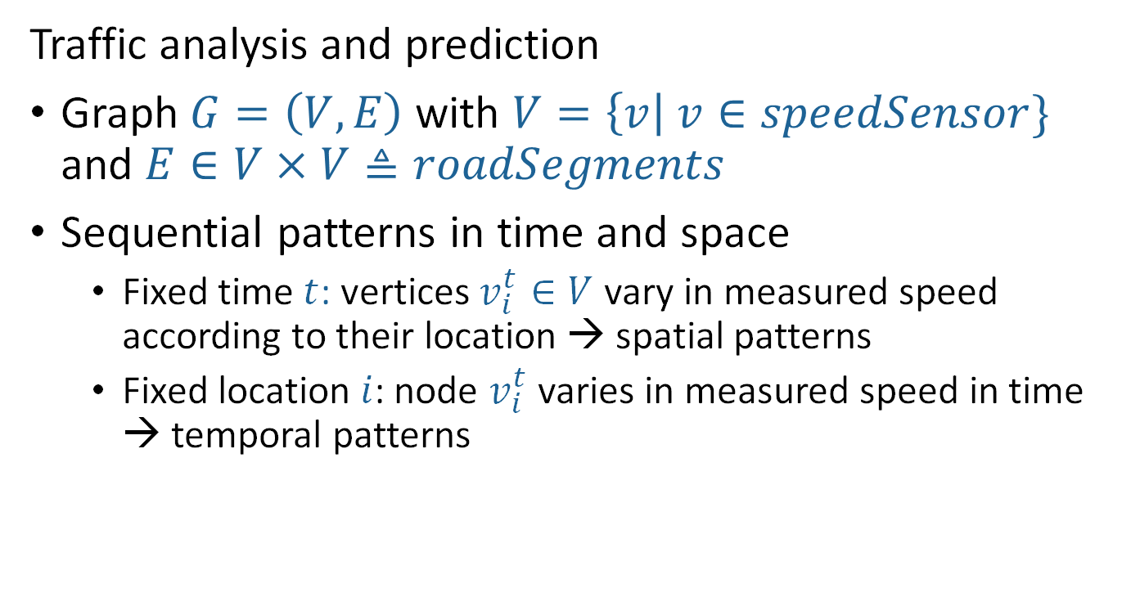
Spatio Temporal Graph Neural Networks
Traffic analysis and prediction
Graph $G=\left(V,E\right)$with $V=\left\{v\right| v∈speedSensor\}$ and $E∈V×V≜roadSegments$
Sequential patterns in time and space
Fixed time $t$: vertices $v_{i}^{t}∈V$ vary in measured speed according to their location → spatial patterns
Fixed location $i$: node $v_{i}^{t}$ varies in measured speed in time → temporal patterns

Slide 3
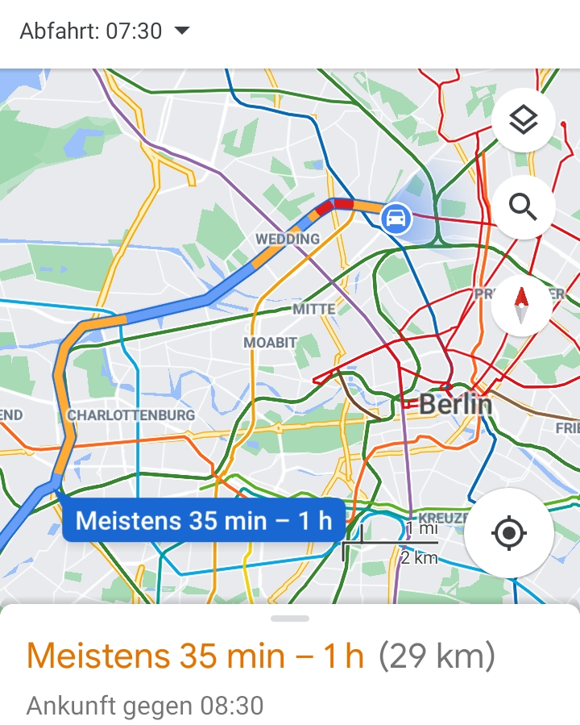
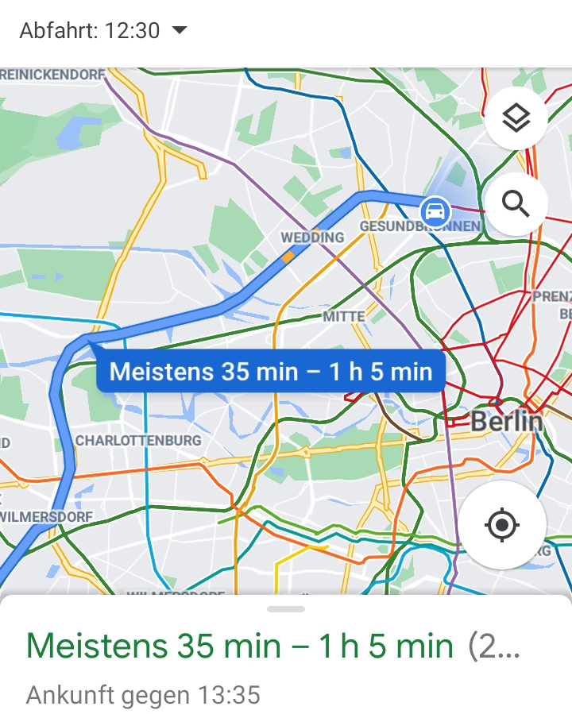
Traffic Prediction Example: Google Maps

Slide 4
Datasets – Loop Detectors (Cui et al. 2018; Li et al. 2018)
METR-LA: Highway of Los Angelos
207 Sensors; Mar 1st 2012 – Jun 30th 2012 (5 min. time intervals)
PEMS-Bay: Bay Area
Performance Measurement System (PeMS) – CalTrans
325 Sensors; Jan 1st 2017 to May 31th 2017 (5 min. time intervals)
Seattle Loop Data: Seattle Area
323 Sensors; Entire Year 2015 (5 min. time intervals)

Slide 5
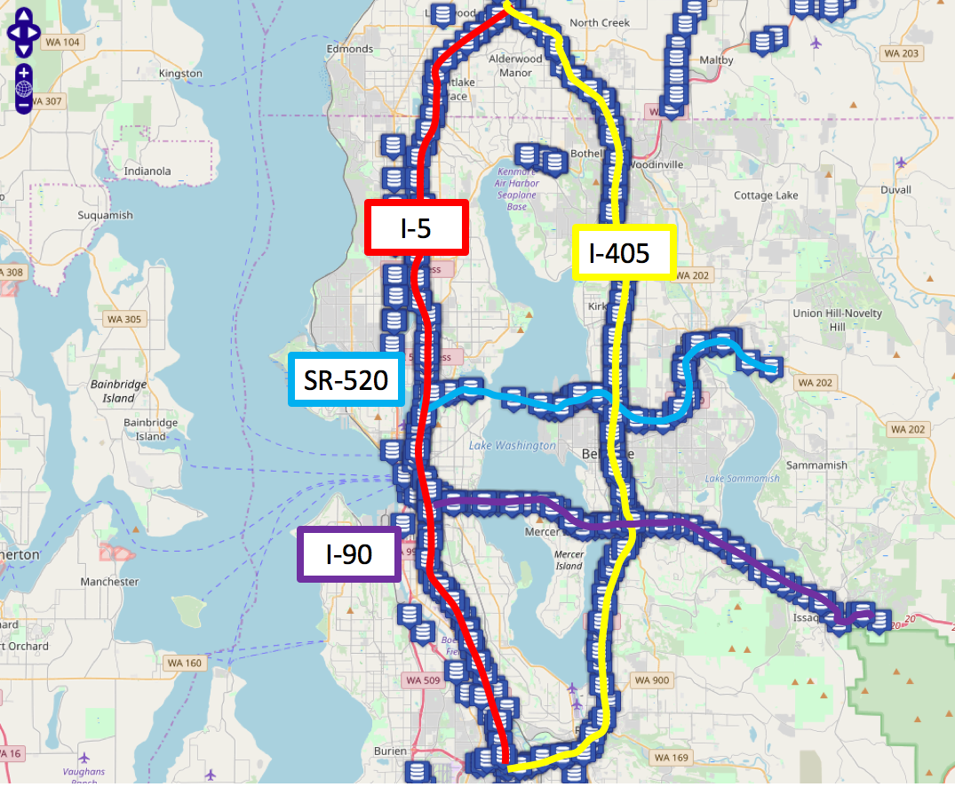
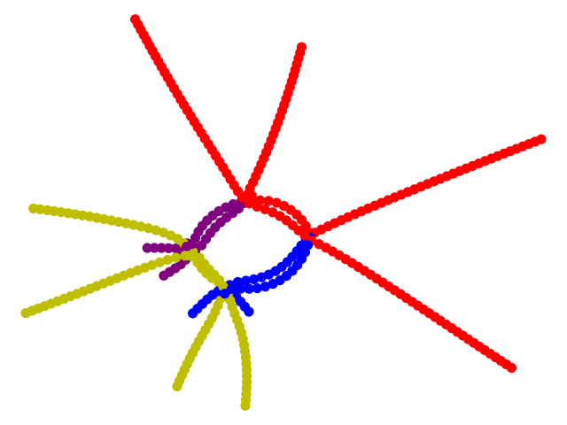
Seattle Loop Data (Cui et al. 2018)

Slide 6
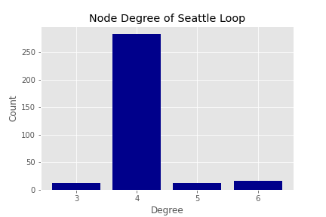
Seattle Loop Data (Cui et al. 2018)
Nodes: 323
Edges: 662
Diameter: 79
Avg. Clustering: 0
Connected Graph

Slide 7
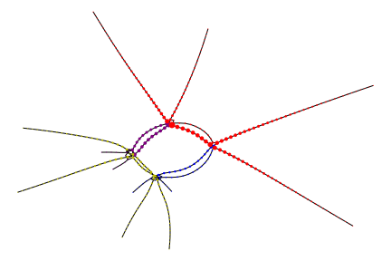
Seattle Loop Data (Cui et al. 2018)
Node centrality:
- The size of the nodes are given by the exponential of the betweenness centrality
- We can see that the nodes in the interssections have a larger betweeness centrality
Node Centrality

Slide 8
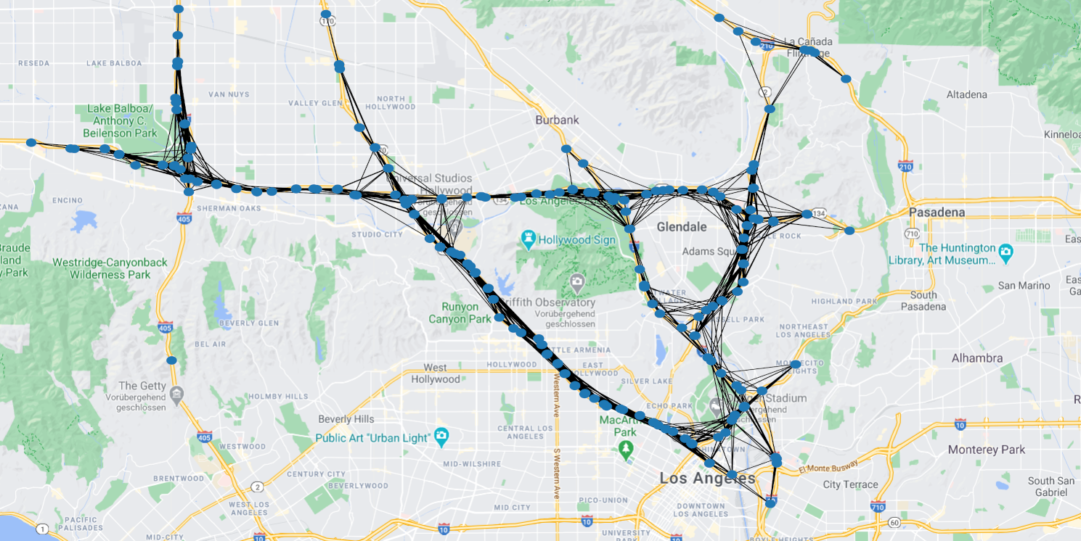
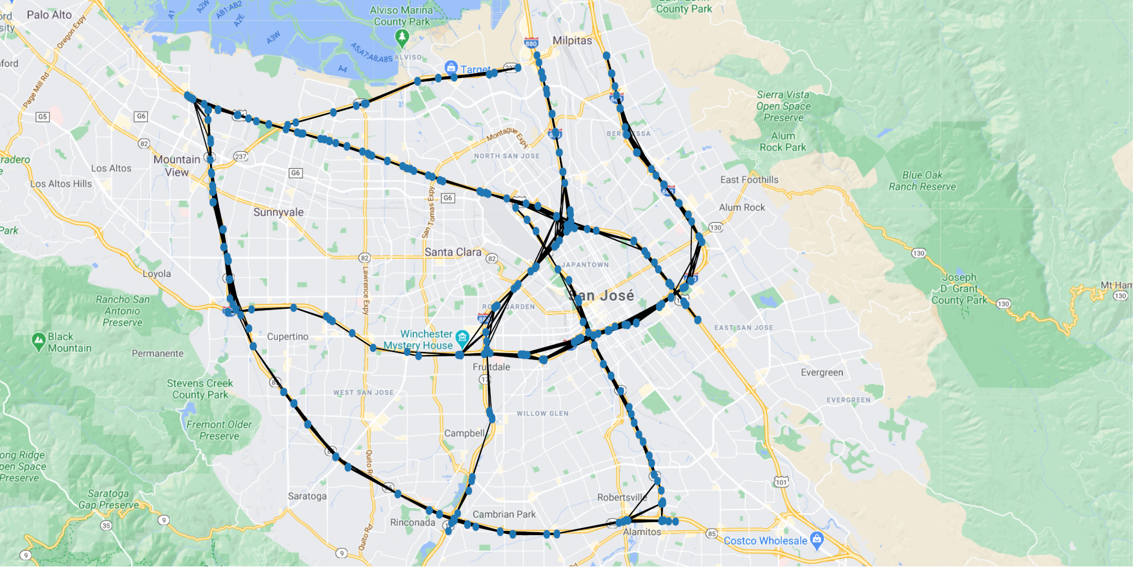

METR-LA and PEMS-Bay Area (Li et al. 2018)
$G=\left(V,E,W\right)$with weighted Adjacency $W_{i,j}=\left\{\begin{aligned}\exp\left(−\frac{dist{\left(i,j\right)}^{2}}{2θ^{2}}\right) if dist\left(i,j\right)≤k \\ 0 otherwise \end{aligned}\right.$

Slide 9
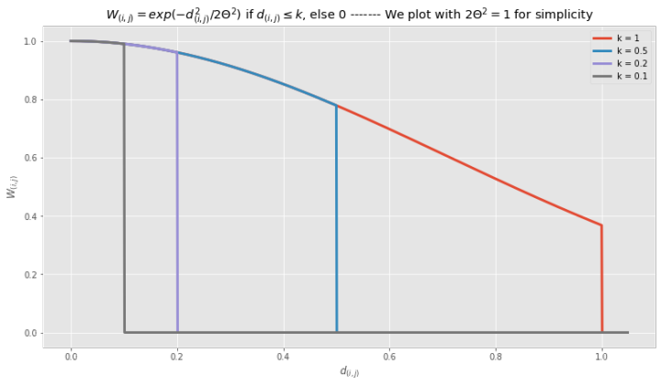

METR-LA and PEMS-Bay Area (Li et al. 2018)
$G=\left(V,E,W\right)$with weighted Adjacency $W_{i,j}=\left\{\begin{aligned}\exp\left(−\frac{dist{\left(i,j\right)}^{2}}{2θ^{2}}\right) if dist\left(i,j\right)≤k \\ 0 otherwise \end{aligned}\right.$

Slide 10
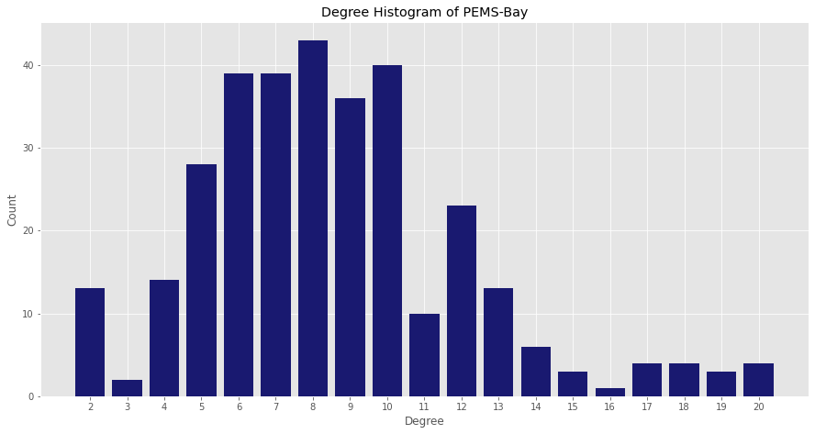
PEMS-Bay: Bay Area
Nodes: 325
Edges: 1390
Avg. Clustering: 0.67
Not-connected Graph
- There are few nodes not
connected due to the
threshold given by k

Slide 11
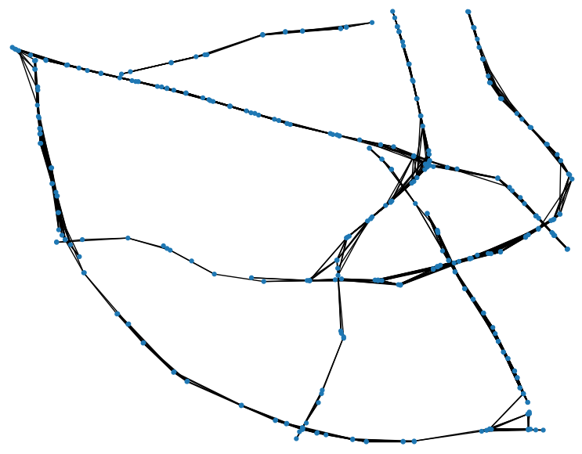
PEMS-Bay: Bay Area
Node Centrality
Node centrality:
- The size of the nodes are given by the exponential of the betweenness centrality

Slide 12
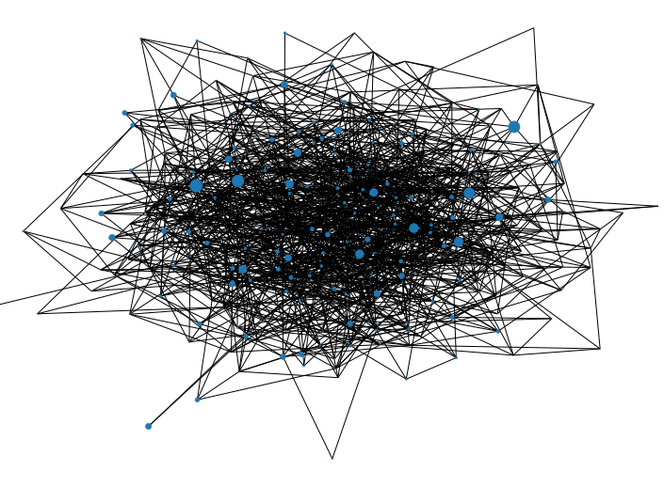
PEMS-Bay: Bay Area – Null model
Erdős-Rényi random graph

Slide 13
PEMS-Bay: Bay Area – Null model
Erdős-Rényi random graph
Graph information | PEMS-Bay | Erdős-Rényi
Nodes | 325 | 325
Edges | 1390 | 1301
Avg Clustering | 0.67 | 0.024

Slide 14
Related Work (1)
Traffic Graph Convolutional Recurrent Neural Network | (Cui et al. 2019)
ST-MetaNet: Urban Traffic Prediction from Spatio-Temporal Data Using Deep Meta Learning | (Pan et al. 2019)
Spatio-temporal Graph Convolutional Networks: A Deep Learning Framework for Traffic Forecasting | (Yu et al. 2018)
Diffusion Convolutional Recurrent Neural Network: Data-Driven Traffic Forecasting | (Li et al. 2018)
ST-UNet: A Spatio-Temporal U-Network for Graph-structured Time Series Modeling | (Bing Yu, Haoteng Yin and Zhanxing Zhu 2019)

Slide 15
Related Work (2)
Graph WaveNet for Deep Spatial-Temporal Graph Modeling | (Wu et al. 2019)
Multi-Range Attentive Bicomponent Graph Convolutional Network for Traffic Forecasting | (Chen et al. 2020)
Gated Residual Recurrent Graph Neural Networks for Traffic Prediction | (Chen et al 2019)
Attention Based Spatial-Temporal Graph Convolutional Networks for Traffic Flow Forecasting (ASTGCN) | (Guo et al. 2019)
Spatio-Temporal Graph Structure Learning for Traffic Forecasting | (Zhang et al. 2020)

Slide 16

$$Research on Complex Systems − Robert Koch Institute \& Humboldt University of Berlin$$

Slide 17
Seattle Loop Data (Cui et al. 2018)
 | Nodes | Edges | Diameter | Avg. clustering | Connected?
Seattle Data | 323 | 662 | 79 | 0 | Yes
Random Graph p=0.1 | 323 | 514 | N/A | 7.69e-3 | No

